Slide 1
  EADTU-EU SUMMIT
  Brussels
  15th April 2016
  Drs. George Ubachs, Managing Director EADTU

Slide 2
Main challenges in Higher Education
Challenges with regard to excellence in teaching
Large student numbers - low student staff ratios /personalised learning
Challenges with regard to education and innovation
Research and innovation - delivering high quality education by involving students in research
Challenges with regard to inclusiveness
According to EU2020 goals education is not exclusive anymore.
Making education accessible for many more students.
Solutions require rethinking and redesigning campus education -> new modes of teaching and introducing ICT based learning

Slide 3

Development of a vision
Personalized teaching and learning , putting the students with their ambitions and talents at the centre, with individual learning arrangements. Learning tools and learning analytics with personalized feedback make this possible.
Small scale and intensive education, looking for a balance between education for qualifications, socialization and personal development. All this together is Bildung. Smaller scale is made possible by learning communities.
Rich learning environments relating to research and professional employment, involving the student
Openness to learners through flexible, inclusive structures and methods that take higher education to students when and where they need it. Education is not exclusive. More than 50 pct. Of an age cohort follows a form of higher education
networked education and mobility, where students can learn across national, sectoral and institutional boundaries.
Enhancing staff quality in the framework of systemic change

Slide 4
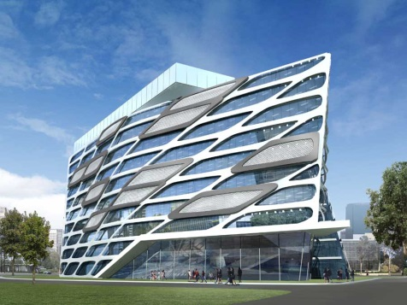
The university of tomorrow
Three complementary educational segments are emerging:
Blended and online mainstream education
Blended and online continuous education
Non-degree education and online open education and MOOCs
More open, more productive, more efficient

Slide 5
Enablers for innovation
Promoting leadership for institutional change
Learning technology tools, systems and services
Professional development of teachers
Communities of practice
The development of shareable resources
The support of evaluation and research evidence

Slide 6
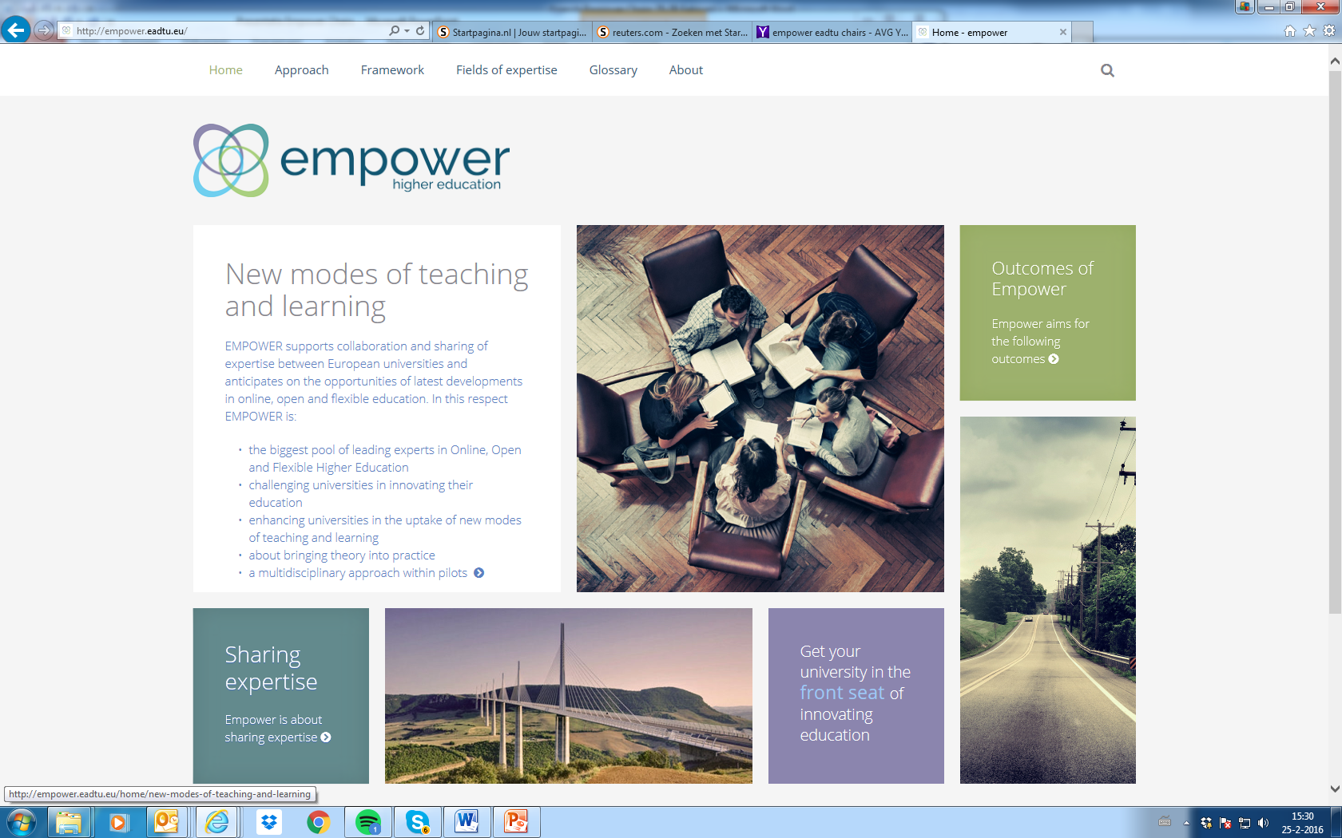

Slide 7

Fields of expertise
Curriculum development and course design
Knowledge resources
Student support
Assessment, examinations and certification
Institutional support; ICT, media and educational support services
Institutional policy development for new modes of teaching and learning
Transnational education
Open & flexible education
OERs & MOOCs
QA in online education
Blended education
Continuous professional development (CPD)

Slide 8
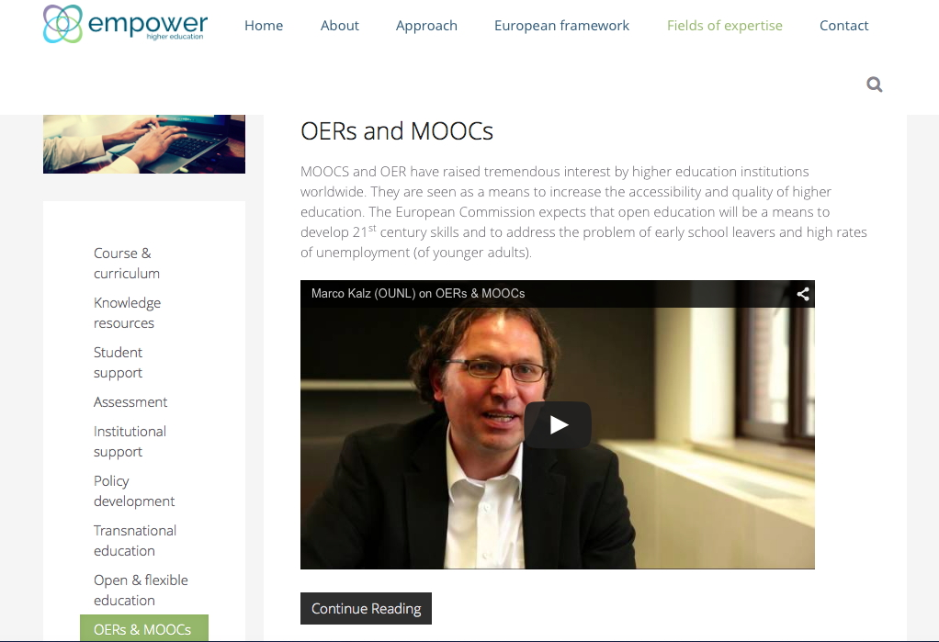

Slide 9


Universities within EMPOWER
Aarhus University
Anadolu University
Dublin City University
FernUniversität in Hagen
Fédération Interuniversitaire de l'Enseignement à Distance
Hogeschool Gent
Hellenic Open University
Johannes Kepler University Linz
KU Leuven
Open University of Israel
Open University of Cyprus
Open University of the Netherlands
The Open University
Universidade Aberta
Universidad Nacional de Educación a Distancia
UniDistance/Fern Schweiz
Università Telematica Internazionale UNINETTUNO
University of Ljubljana
Universitat Oberta de Catalunya

Slide 10

Exchange of experties
Show-share-generate expertise
Sharing expertise within the expert pools
In 2016 we start with sharing expertise in Webinars, Master classes, hot-topic discussions, pilots and the Leadership Academy

Slide 11
The Expert pools are invited to organise 3 of the below mentioned activities per year:
1. Hot topic round table discussion (panel discussion of max. 5 presenters starting with 5 minutes introduction, participant observers potentially the full EMPOWER experts group)
2. Webinar (presentation of expert from FOE, participant observers potentially the full EMPOWER experts group)
3. Master class (series of) course-like/educational presentation(s), participant observers potentially the full EMPOWER experts group and the world)
4. Case study (experiences from practice from one or more presenters, participant observers potentially the full EMPOWER experts group)

Slide 12


Slide 13
Publication
EADTU’s EMPOWER advice paper on 12 fields of expertise in new modes of teaching

